Slide 1
Qur Apps v1.73 demo

Slide 2
Auto-refresh alert dashboard
Auto-refresh time for receiving alerts automatically on the alert dashboard could by set by care coordinators from the settings screen
A notification appears based on the duration set to alert the cc that there are newer alerts
CC can choose to refresh immediately, else the screen will be refreshed automatically at the end of the notification
Click here to see the demo video

Slide 3
CC Time-off setting
The time selection fields in settings screen has been enhanced to select the time instead of entering a value
Time difference of every 5 minutes can be chosen by picking a value from the drop down or by entering a value manually
Click here to see the demo video

Slide 4
Plan status filter has additional options to filter for patients
The plan status filter in patient list has a revised list of options:
  Active – To filter for patients who are currently active on a plan
  Inactive – To filter for patients whose plans are expired or unsubscribed
  No Plan – To filter for patients who have not taken any plan
  All – To filter for all patients with above statuses
Click here to see the demo video

Slide 5
Provider Phone number on Appointment Booking screen
On the appointment booking screen, after choosing the provider's name for On-site appointments, the provider’s phone number with country code is populated along with the address for reference.
Click here to see the demo video

Slide 6
Revised Settings UI
The Settings screen for providers, has a revised UI where a menu is introduced on the left instead of tabs
Users can click on the menu 1 by 1 to settings the relevant setting’s options on the right
The currently chosen menu is highlighted on the left for identification
The main menu is automatically hidden when settings screen is visible
Click here to see the demo video

Slide 7
Filter patients by custom field values and assign surveys
On the assign survey screen, after entering the cadence details. The patients on the patients list can be filtered by custom field values
Note: Custom fields are the additional fields that are captured by the Health Organization for their patients apart from the default fields mentioned in the patient profile.
Click here to see the demo video

Slide 8
Simplified Plan Approval
The plan approval process is made easier where making edits, submitting for approval, approve and publish process can be done on the same screen
Note: Approve and Publish option would be available only for users with Approve rights for the Plan management module
Click here to see the demo video

Slide 9
View and Edit Survey activity responses
I can view the non-tele call survey activity responses in QurHome and Edit the responses
Click here to see the demo video

Slide 10
Sheela – Query all medication activities in the day
I can query Sheela on all the medication activities that are scheduled for the day (Past and Future activities)
Click here to see the demo video

Slide 11
Sheela – Query Missed & immediate next
I can query Sheela on the missed medications for the day
I can query Sheela on the immediate next medication activity that I have to follow
Click here to see the demo video

Slide 12
Sheela – Query all future activities
I can query Sheela on the upcoming activities for the day
Click here to see the demo video

Slide 13
Sheela – Synonyms to query medication activities
I can use other synonyms to query medication activities
Click here to see the demo video

Slide 14
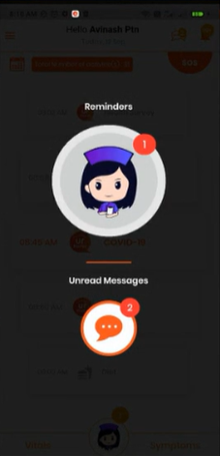
Sheela – Reminder queue has new indication for unread messages
A new section is included in Sheela Reminder Queue for “Unread messages”

